Slide 1
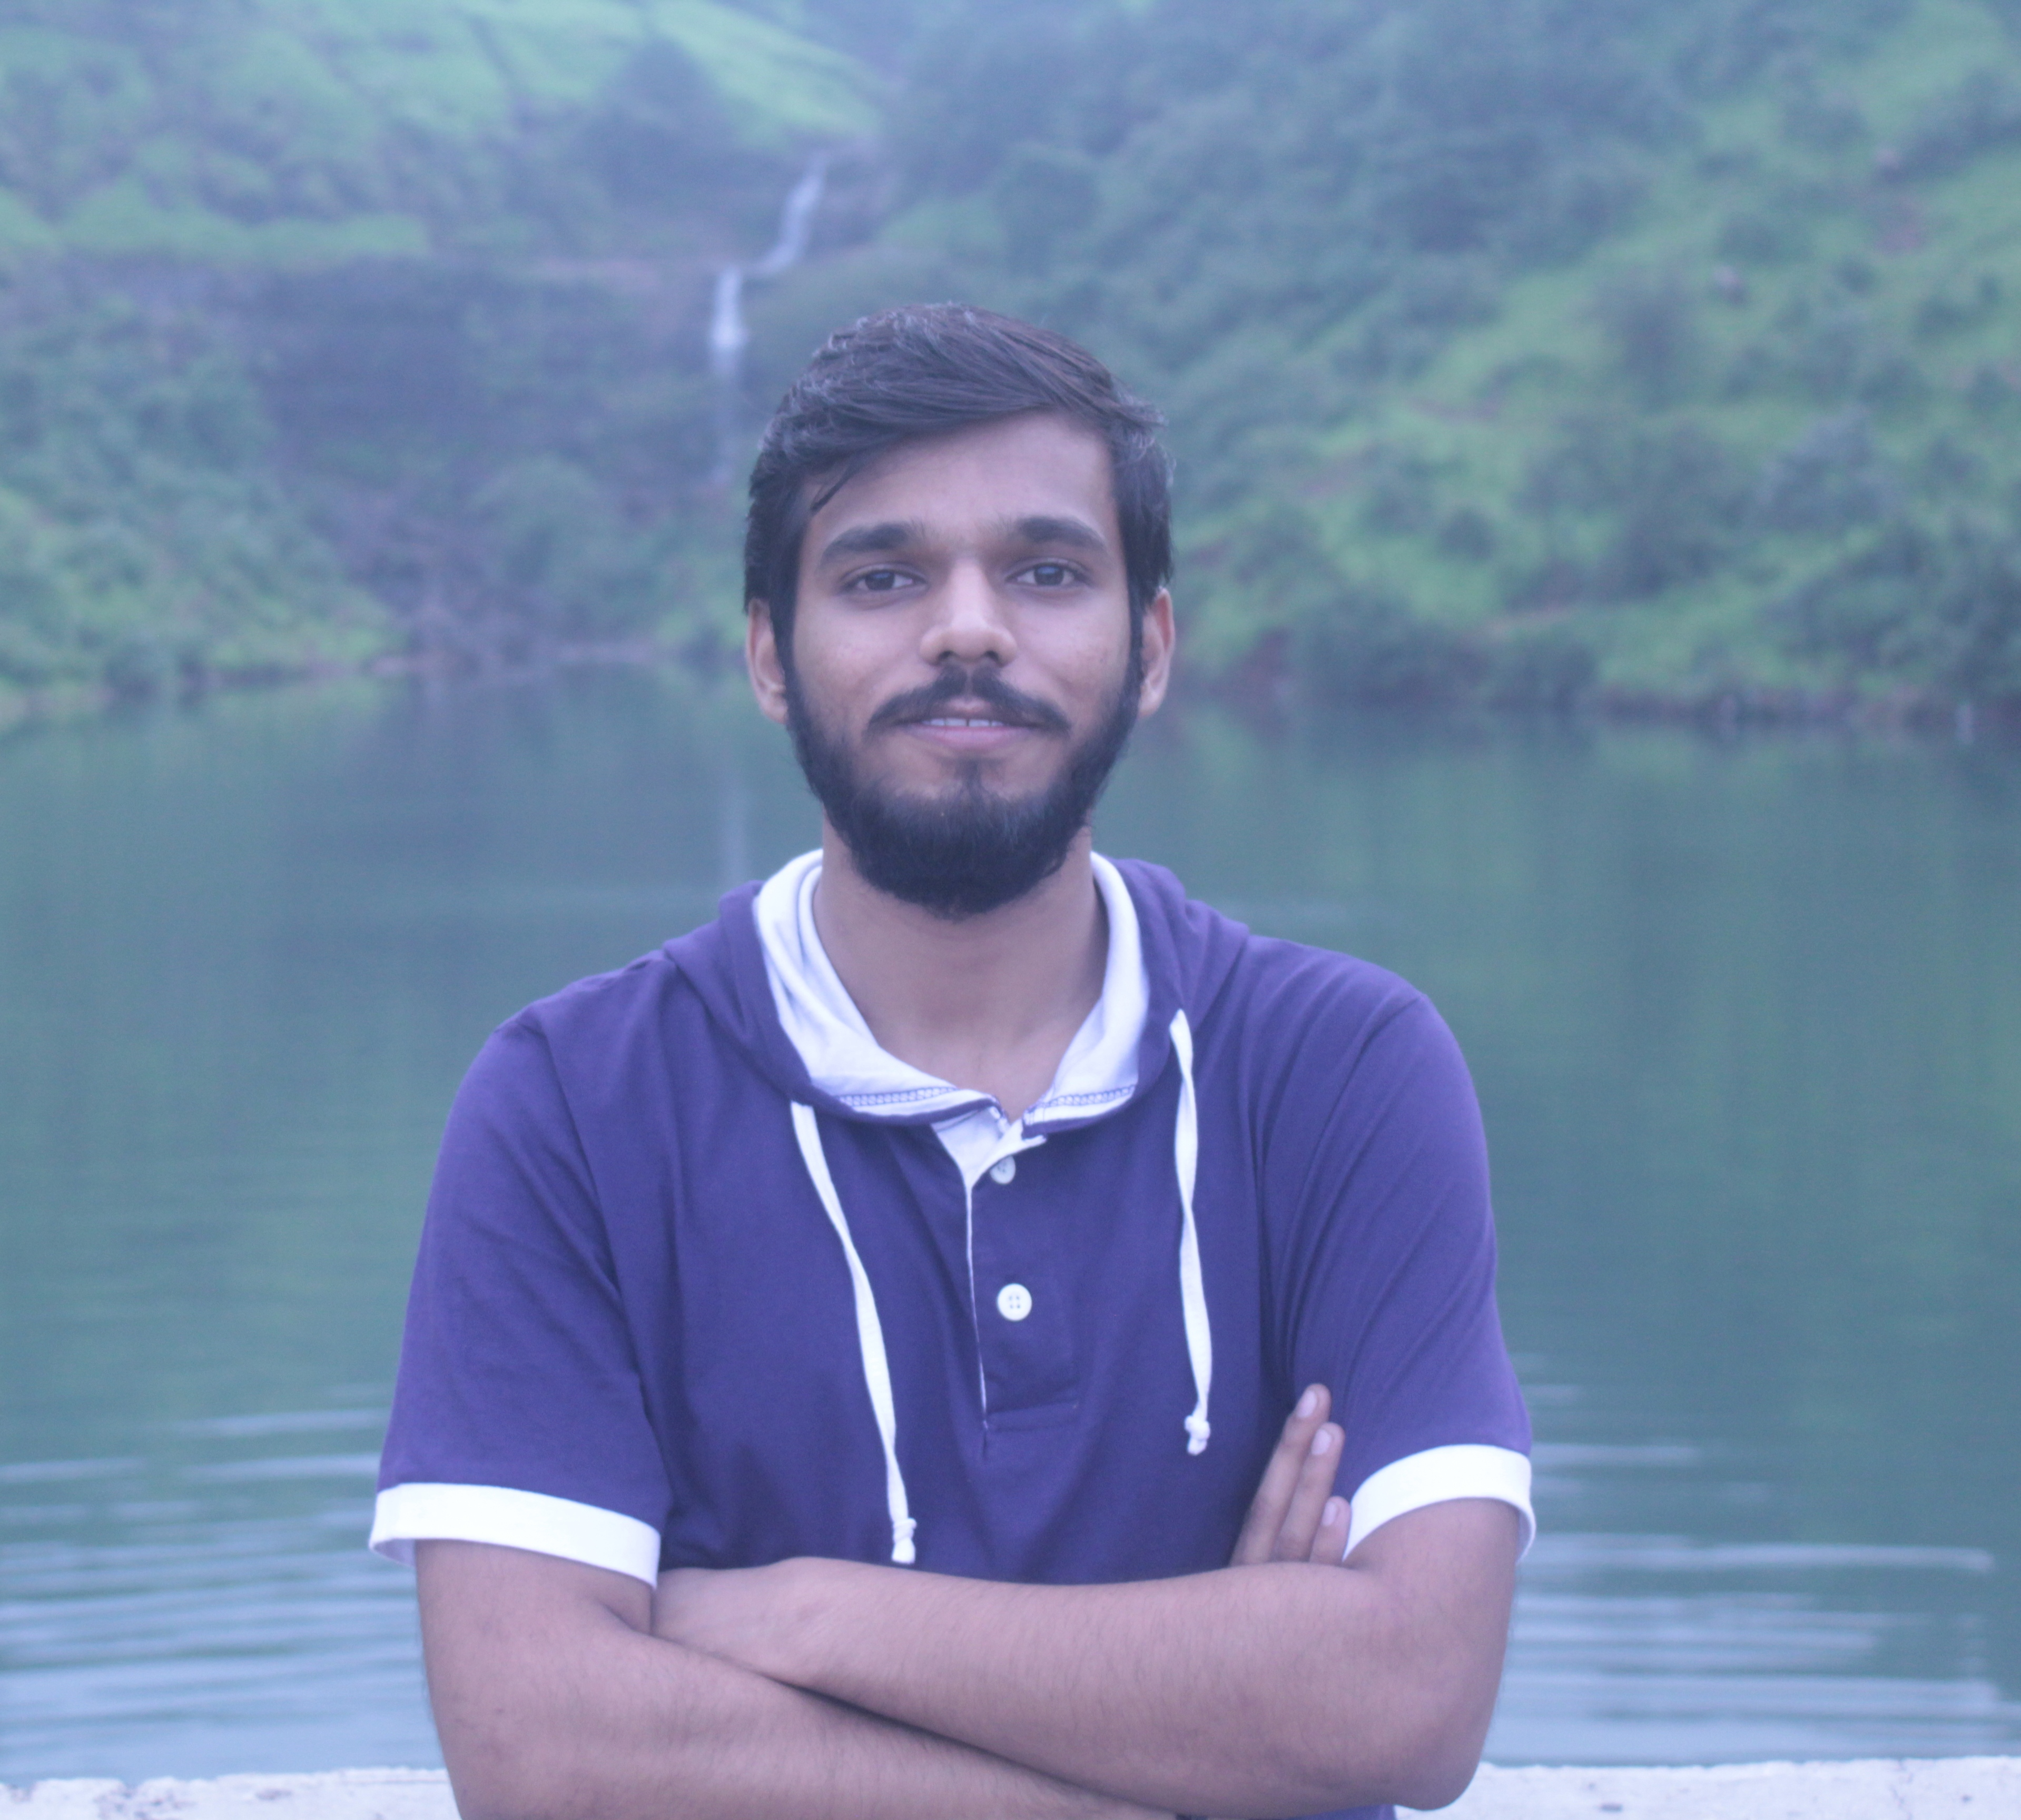
First Stint (Aug-Sep) :
My Key Learnings
Explored business side of retail assets by interacting with various stackholders.
Performed end to end testing on INDUS LOS, Agri LOS for various scenarios.
COE: Aliasgar Karachiwala
Coaches: Moumita Sharma and Nadeem Khan
Second Stint (Oct-Dec) :
Used Finacle UAT (FINCORE) for NEFT, RTGS transactions.
Understood the process of Clearing in parallel with testing for ESCROW.
Got an overwiew of finacle architecture.
COE: Vaibhav Rastogi
Coaches: Amit Nair and Sanket Joshi
Third Stint (Jan-Mar) :
COE: Deepa S
Coach: Suryakant Ankolekar
Built jobs on ETL tool TALEND for big data integration.
Created a DUMP for BFL Online
Narendra Pal Singh
Mechanical Engineering (B.Tech) IIT Bombay
Attended a workshop on Advanced Excel held by the bank.
Overall got an exposure to business as well as technical fields in the bank during last one year
Miscellaneous

